Slide 1


DATA AND SIGNALS

Slide 2
To be transmitted, data must be transformed to electromagnetic signals.

Slide 3
ANALOG AND DIGITAL
Data can be analog or digital.
Analog data refers to information that is continuous
Analog data take on continuous values.
Digital data refers to information that has:
Discrete states.
Digital data take on discrete values.

Slide 4
ANALOG AND DIGITAL
Signals can be analog or digital.
Analog signals can have an infinite number of values in a range
Digital signals can have only:
Limited number of values.

Slide 5
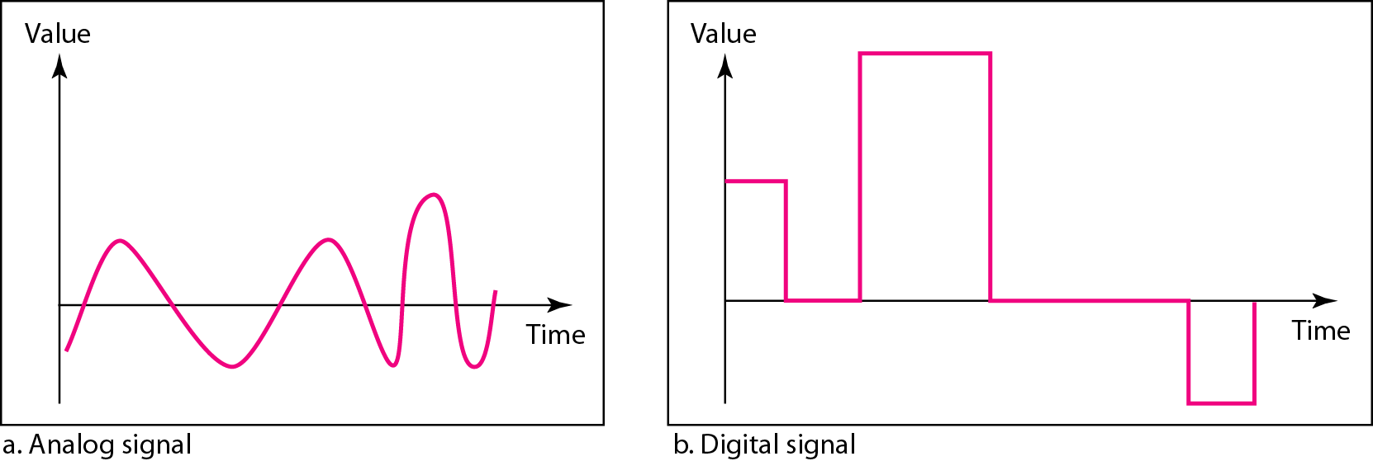
Comparison of analog and digital signals

Slide 6
Periodic and Non Periodic
A periodic signal completes a pattern within:
Measurable time frame, called a period.
Repeats that pattern over subsequent identical periods.
Completion of one full pattern is called as a cycle.

Slide 7
Periodic and Non Periodic
Non-periodic signal:
Changes without exhibiting a pattern or a cycle.
Cycle:
The completion of one full pattern.
A non-periodic signal
Changes without exhibiting a pattern or a cycle.

Slide 8

Note
In data communications, we commonly use:
Periodic analog signals and nonperiodic digital signals.

Slide 9
PERIODIC ANALOG SIGNALS
Periodic analog signals can be classified as :
Simple or Composite.

Slide 10
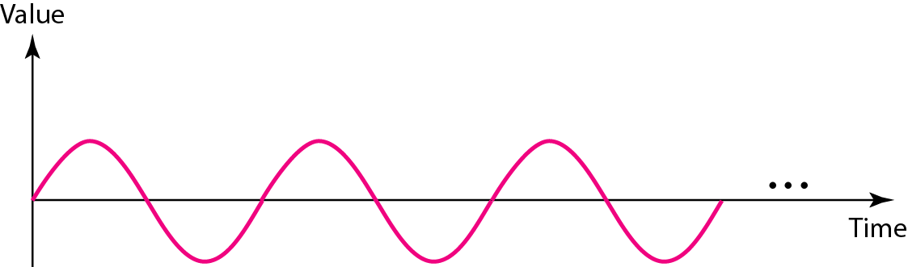
Figure A sine wave

Slide 11
A sine wave is represented by:
Peak Amplitude
Frequency
Phase
Wavelength

Slide 12
Peak Amplitude
Peak amplitude of a signal is the absolute value of its highest intensity
Proportional to energy it carries.
Measured in volts.

Slide 13
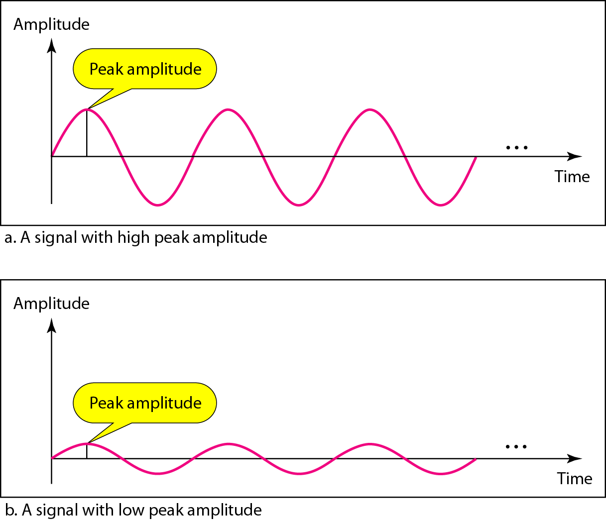
Two signals with the same phase and frequency, but different amplitudes

Slide 14
Period and Frequency
Period refers to amount of time, in seconds, a signal takes to complete one cycle.
Frequency refers to the number of periods in 1 second.
Period is expressed in seconds .
Frequency is expressed in hertz (Hz)

Slide 15

Note
Frequency and period are the inverse of each other.

Slide 16
Note
Frequency is the rate of change with respect to time. Change in a short span of time.
Means- High frequency. Change over a long span of time.
Means- low frequency.

Slide 17
Note
When a signal does not change at all:
Frequency is zero.
When signal changes instantaneously:
Frequency is infinite.

Slide 18
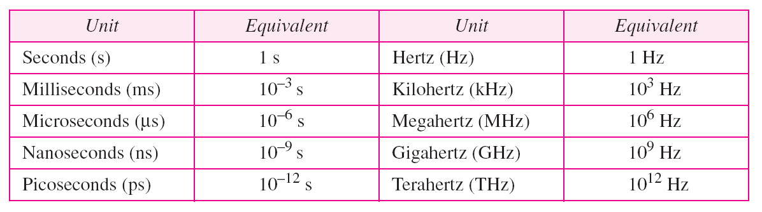
Table Units of period and frequency

Slide 19
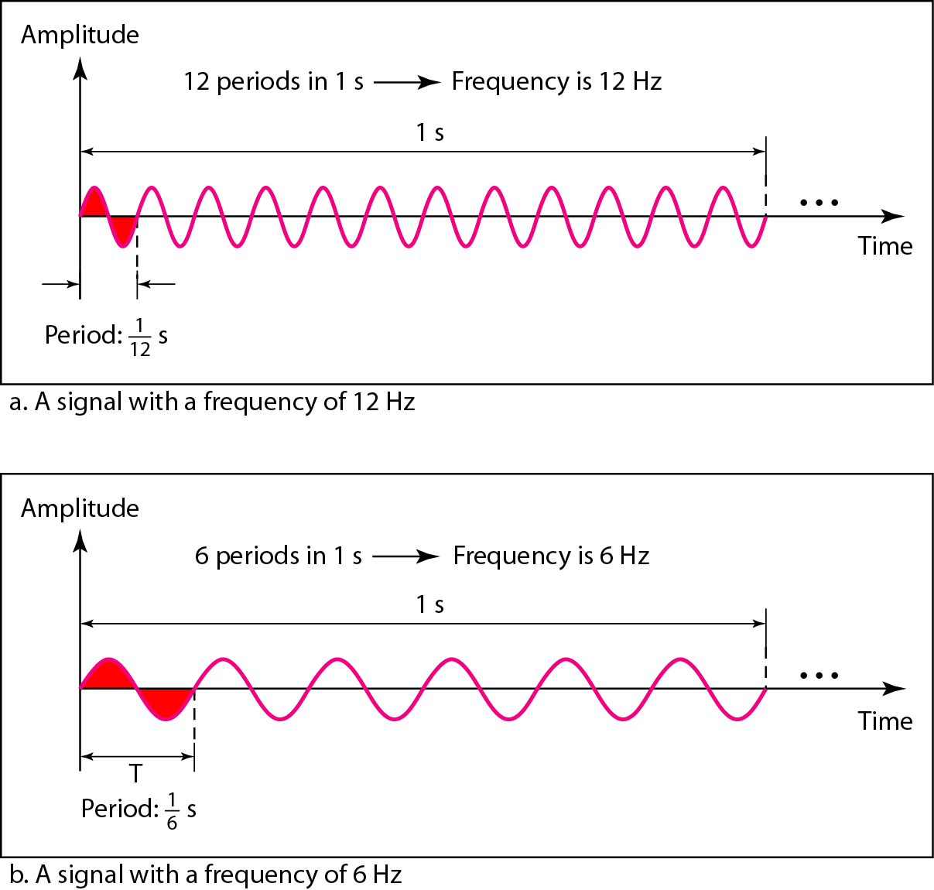
Figure Two signals with the same amplitude and phase, but different frequencies

Slide 20

Example
The power we use at home has a frequency of 60 Hz. Determined the period of this sine wave?

Slide 21
Example
Express a period of 100 ms in microseconds.

Slide 22
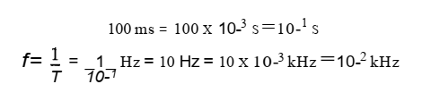
Example
The period of a signal is 100 ms. What is its frequency in kilohertz?
Solution

Slide 23
Note
Phase describes the position of the waveform relative to time 0.

Slide 24
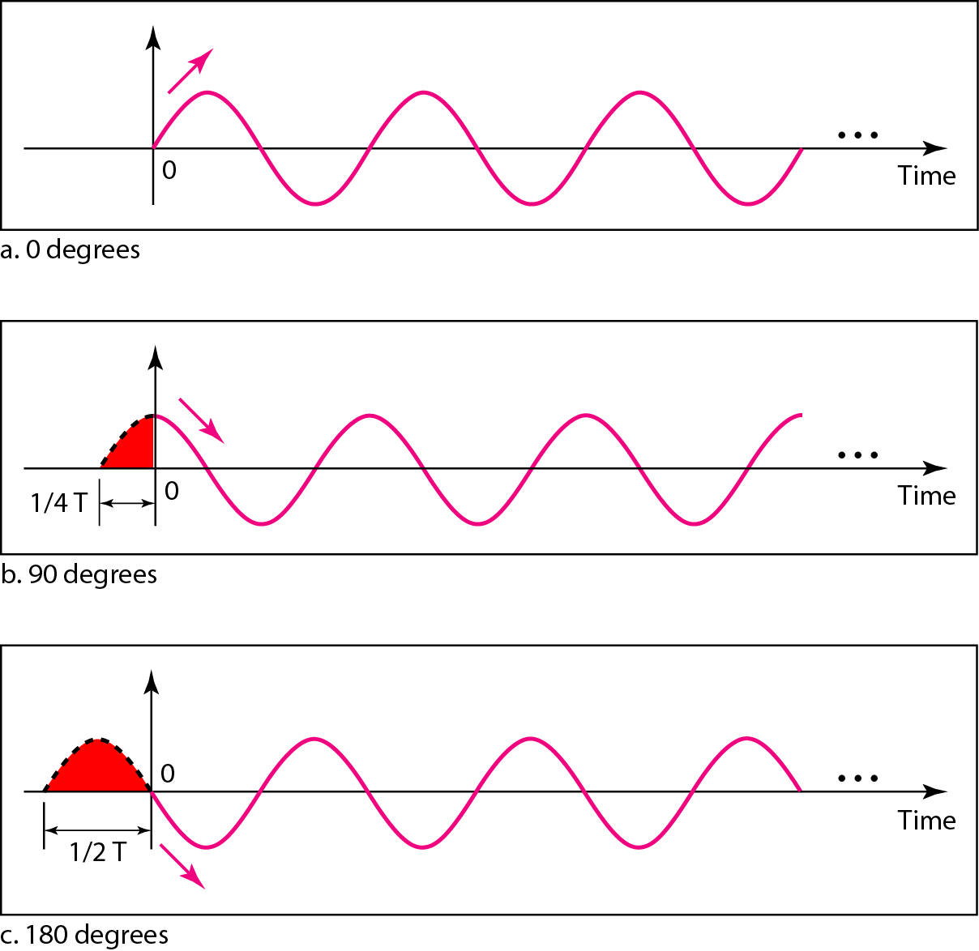
Figure Three sine waves with the same amplitude and frequency, but different phases

Slide 25

Example
A sine wave with value 1/6 cycle with respect to time 0. What is its phase in degrees and radians?

Slide 26
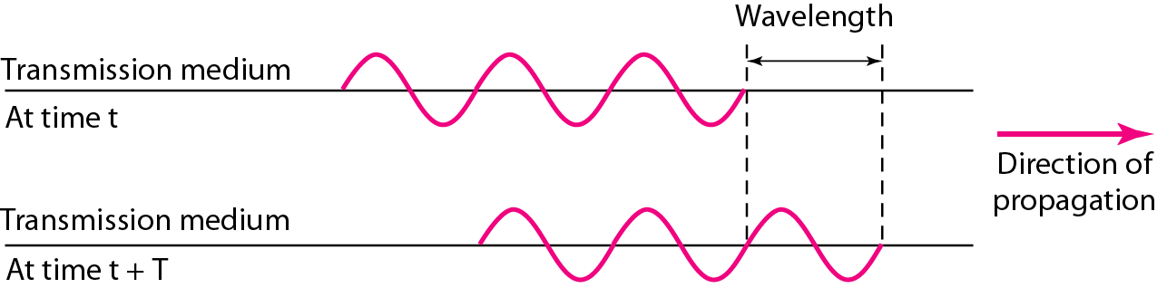
Figure Wavelength and period

Slide 27
Wavelength
Wavelength is the distance a signal can travel in one period.
Wavelength= propagation speed* period
Or
Wavelength= propagation speed/ frequency

Slide 28
What are we?
I'm the beat in every wave you see, Time and cycles define me precisely.
When I'm high, change comes fast,
When I'm low, the changes don't last.
My cousin shows how long I take,
And yet another tells how far I make.
Together we shape the signals you know—
Guess us all in one clever go!
Notes:
Answer: Frequency, Period, Phase, Wavelength
Justification:
- 'Beat in every wave' and 'cycles' relate to frequency.
- 'High = fast change' and 'low = slow change' refer to frequency levels.
- 'How long I take' points to period.
- 'How far I make' indicates wavelength.
- Together they define wave characteristics.
- Phase is implied in the synchronization and timing among waves.

